Slide 1


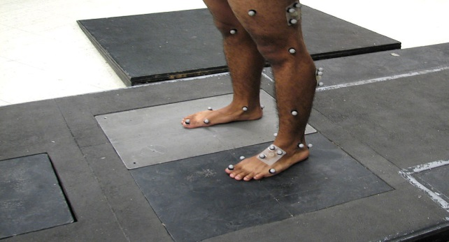

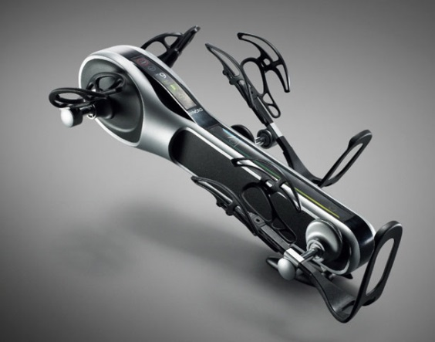
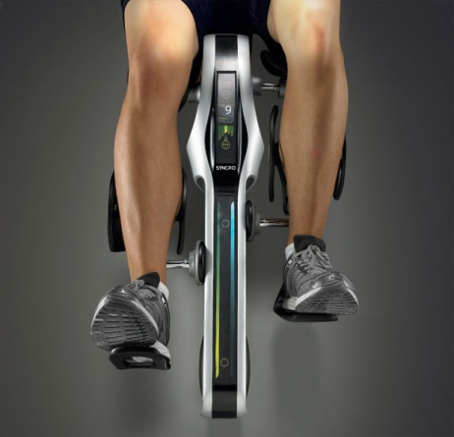
Sensory Data
Video Capturing
Streaming Multimedia
Rehabilitation Device

Slide 2
Platform
Profile based Platform of Rehabilitation
Profile description of Rehabilitation Devices
Profile description of Sensors
Profile description of Video Streaming
Modular structured platform based on Profile
Modular structure with profiles
Modular interface description with profiles

Slide 3
Rehabilitation Work Bench (named with “Rehabilitation Studio”)
Functioning Modular Description
Sensory Data Streaming Interface (DataStreaming Module)
Analog Signal Processing (ASP Module)
Digital Signal Processing (DSP Module)
Wireless Communication (WiComm Module)
Rehabilitation Device Interface (DeviceControl Module)
Control and Management (RehabManager Module)
Monitoring and Controlling
Profile Database
Decision Management Database

Slide 4
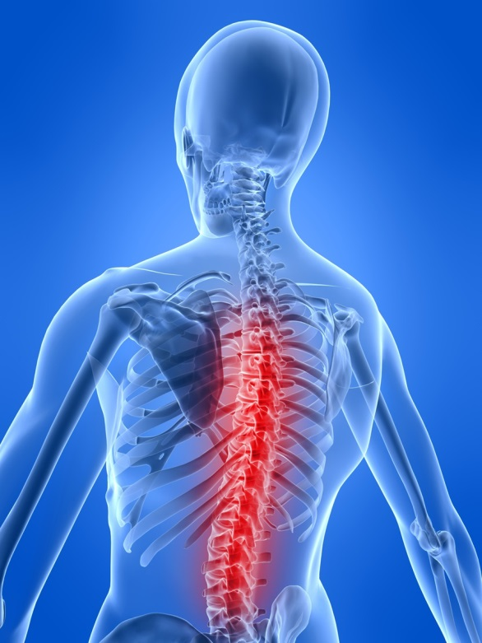
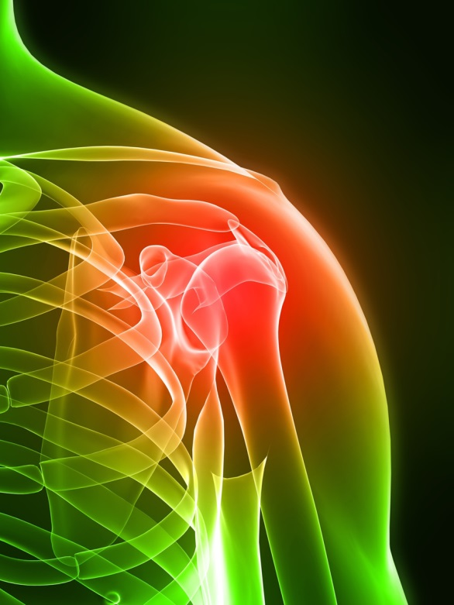
Sensor
DataStreaming Module
Rehab Manager
Profile Database
Video
ASP
Module
Decision Manager DataBase
DSP
Module
WiComm
Module
WiCom
Module
Rehabilitation Device
DeviceControl
Module

Slide 5
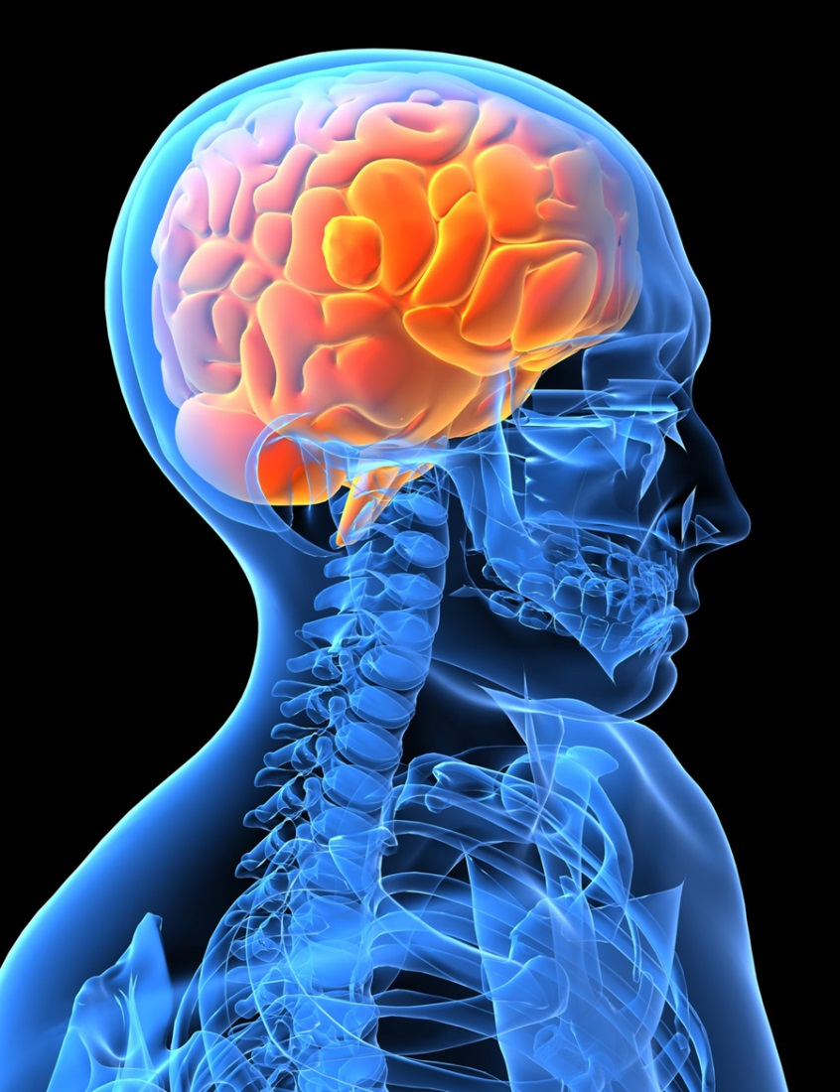
Application Example.
Brain Activity Imaging
Sensor Array
DataStreaming Module
EEG Manager
Profile Database
y
z
x
ASP
Module
Location
Control
DSP
Module
10
6
WiComm
Module
WiCom
Module
y
Decision Manager DataBase
z
x
DisplayControl
Module
Location
Mapping

Slide 6
Video Streaming and Control
Scalability Control
SNR, Spatial Domain Scalability
Temporal Streaming
Multiplexed Streaming
Sensory Data and Captured Image(Motion)
Control/Command for Scalability
Device Control
Rehabilitation Device Control
Autonomous Feedback Control

Slide 7
Application
Motion Wellness Progress Tracking System
Pediatric Rehabilitation
Orthopedic Rehabilitation
Therapical Clinics at Home
Physical Therapy
Feedback and Tracking of Motion Wellness

Slide 8
Other Applications
Speech and Language Recovery
Text Prompter/ Audible Device may apply
Speech Recognition system
Preventing Obesity
Vital sign monitoring(BP, ECG, HBR…)
Physical Training Program for Weight Loss
Self-Management of food control with Calorie monitoring
BCI with Prosthetic Device

Slide 9
Technology
Digital Image Processing with Streaming
SNR(QoS) Scalability
Spatial Domain Scalability
Temporal Streaming with Data/Command
Mobile Rehabilitation (Medical) Data Communication
Profile based Platform for Rehabilitation Devices and Data types
Pro-Active Scalability Control by Feedback

Slide 10
Technology
Rehabilitation Device Control
Profile based common Platform for Configuration/Control
Rehabilitation Program Database
Autonomous Controlling the Rehabilitation Devices by Feedback

